Slide 1
AI-assisted Software Development Trends and Themes
Don Syme
Principal Researcher, GitHub Next
QUT, April 2026
Notes:
Note: Put phone on do not disturb, Slack to not notify, Teams closed
Thank you for the introduction, Rahul. Again, my name is Eddie Aftandilian. I’m a principal researcher in GitHub Next, and today I’ll be sharing some lessons that we have learned from building GitHub Copilots.

Slide 2
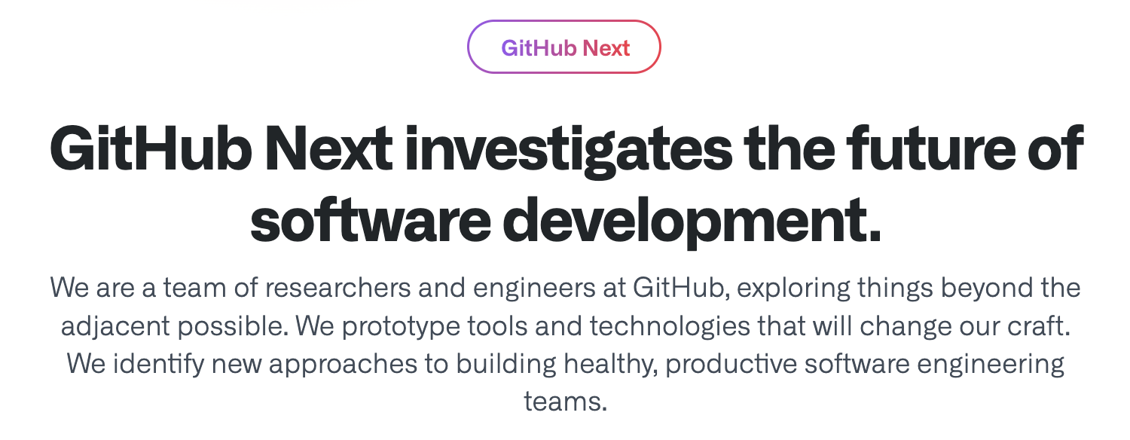
GitHub Next
Research, Build, Balance, Ship, Learn

Slide 3
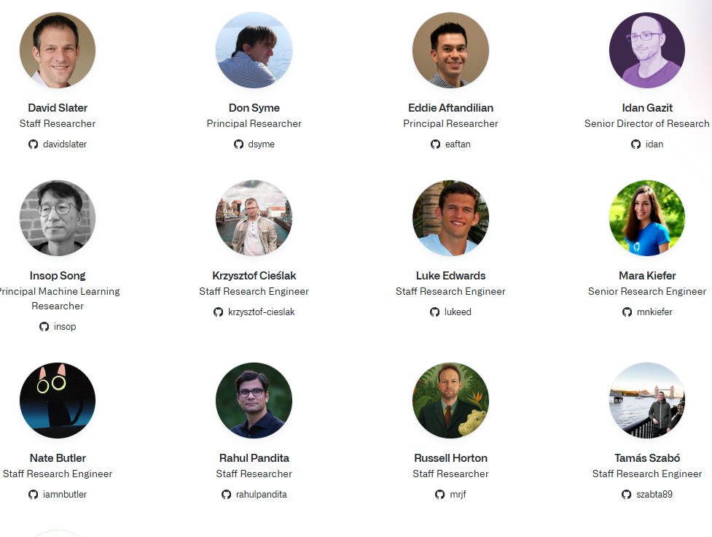
The GitHub Next Team
Notes:
I’m representing the work of an amazing team
Currently 18 people
Mix of backgrounds and skillsets
Frontend, backend, ML, programming languages, user research, etc.
It takes this diverse mix of skillsets to build new AI developer tools

Slide 4
Your Big Questions!
“What will coding with AI look like in the future?”
“Does AI mean that code will be obsolete soon?”
“How should I use AI tools in software development?”

Slide 5

We live in the most incredible of times
AI and traditional dev tools make us all magicians when it comes to code
Everything is changing, yet continuity is there too
Notes:
AI developer tools are changing the way we write software.
GitHub Copilot was one of the first such tools. It launched as a technical preview (essentially a closed beta) in June 2021. Today it has 1.8M paying users, and 50% of those users’ code is written by Copilot. Other companies such as Google report similar proportions of AI-generated code for their comparable AI code completion tools.
This will only increase as the next generation of tools comes online. These are tools that approach the problem at a higher level – for example, completing an entire development task as opposed to completing a line of code or a function
Copilot Workspace, Devin, Cursor, et al.

Slide 6

We live in the most incredible of times
AI and traditional dev tools make us all magicians when it comes to code
Everything is changing, yet continuity is there too
Notes:
AI developer tools are changing the way we write software.
GitHub Copilot was one of the first such tools. It launched as a technical preview (essentially a closed beta) in June 2021. Today it has 1.8M paying users, and 50% of those users’ code is written by Copilot. Other companies such as Google report similar proportions of AI-generated code for their comparable AI code completion tools.
This will only increase as the next generation of tools comes online. These are tools that approach the problem at a higher level – for example, completing an entire development task as opposed to completing a line of code or a function
Copilot Workspace, Devin, Cursor, et al.

Slide 7
AI Dev Tools are changing fast
2022: GitHub Copilot Code Completions launched.
1.8M+ paying users, 50%+ of users’ code is written by Copilot
2023: AI Assists expand in traditional Developer Environments
Summarization, advice, code review, e.g. Cody and others
2024: Shift to Task-orientation
GitHub Copilot Workspace, Cursor Composer, Devin bring task-orientation to the IDE
2025: Coding Agents developed to explore and use tools
Cursor/VS Code Agent-Mode, Claude Code and others launched
2025: AI-assisted app development introduced
GitHub Spark, Bolt, Gemini, Lovable, Cogna, …
2025: Continuous AI introduced
GitHub Agentic Workflows, Google Jules, Curor Automations
Proactive, automated use of AI

Slide 8
AI DEV TOOLS
AI CODING AGENTS, PLANNING, TOOL USE
AI ENRICHED SERVICES (e.g. indexing, summaries)
FINE TUNING & INFERENCE & GPUS & HOSTING & ….
MODELS

Slide 9
AI Dev Tool: Super AI Coding Factory
AI Coding Agent: Mistral Vibe
Code Indexed by: GitHub, Augment
Hosted by: Amazon Web Services
Model(s): Claude Opus 4.6

Slide 10
The Big Trends I’m seeing in AI Dev Tooling
AI-assisted Pinpoint Surgery
AI-assisted Task Oriented Surgery
AI-assisted App Development
Continuous AI
Major changes to teamwork and methodology

Slide 11

Theme 1: Pinpoint Surgery
The OG GitHub Copilot completes code in your editor
You are already located at a pinpoint of change
You accept/reject small bits
You have to type quite a lot
Copilot sort of infers what you are trying to do
This is magical: a finely honed surgical assistant

Slide 12
Other pinpoint tools
Type-checking
Intellisense
Code navigation
Code search
Security checking

Slide 13
Other pinpoint tools
Type-checking
Intellisense
Code navigation
Code search
Security checking
AI Code completion
AI Code summarization
AI Code chat
AI Code review
AI Code fix suggestions
AI Test generation

Slide 14
Theme 2: From Pinpoint Surgery to Tasks
Software activity begins with words and intent Before a code change, before a pull request, there are words - a discussion, a bug report, a feature request, an engineering task, a meeting, a design document, an idea.

Slide 15

Theme 2: From Pinpoint Surgery to Tasks
https://www.flaticon.com/free-icons/
Notes:
The original GitHub Copilot completes code in your editor
You have to accept small bits
You have to move your cursor around
You still have to type quite a lot
Copilot has to infer what you are trying to do
Can we switch POV to whole task, whole change, whole repository
While keeping the key learning of Copilot: repeated AI-user alignment

Slide 16
Theme 2: From Pinpoint Surgery to Tasks
Code 🏆🏆🏆
Idea
https://www.flaticon.com/free-icons/
Notes:
The original GitHub Copilot completes code in your editor
You have to accept small bits
You have to move your cursor around
You still have to type quite a lot
Copilot has to infer what you are trying to do
Can we switch POV to whole task, whole change, whole repository
While keeping the key learning of Copilot: repeated AI-user alignment

Slide 17
Theme 2: From Pinpoint Surgery to Tasks
Change 🏆🏆🏆
Change Intent
https://www.flaticon.com/free-icons/
Notes:
The original GitHub Copilot completes code in your editor
You have to accept small bits
You have to move your cursor around
You still have to type quite a lot
Copilot has to infer what you are trying to do
Can we switch POV to whole task, whole change, whole repository
While keeping the key learning of Copilot: repeated AI-user alignment

Slide 18
Theme 2: From Pinpoint Surgery to Tasks
GitHub Pull Request 🏆🏆🏆
GitHub Issue
https://www.flaticon.com/free-icons/
Notes:
The original GitHub Copilot completes code in your editor
You have to accept small bits
You have to move your cursor around
You still have to type quite a lot
Copilot has to infer what you are trying to do
Can we switch POV to whole task, whole change, whole repository
While keeping the key learning of Copilot: repeated AI-user alignment

Slide 19
Theme 2: From Pinpoint Surgery to Tasks
Changing perspective
Pinpoint Surgery → Whole Operation Single Point of Change → Whole Repository Implicit Task → Explicit Task

Slide 20
Theme 2: From Pinpoint Surgery to Tasks
“Add a refresh button to the main page”
“Create end-to-end tests using Playwright”
“Set up continuous integration using GitHub Actions”
“Set up production resources in Azure using Terraform”
“Read coverage report and add unit tests to repo”
“Create a website for UK house prices”
Notes:
The original GitHub Copilot completes code in your editor
You have to accept small bits
You have to move your cursor around
You still have to type quite a lot
Copilot has to infer what you are trying to do
Can we switch POV to whole task, whole change, whole repository
While keeping the key learning of Copilot: repeated AI-user alignment

Slide 21

Theme 3: Automation with SWE-Agents
SWE-Agents are AI robots that have multiple tools to operate on your code.
Can be unreliable, the “sweet zone” requires skill to find. But improving all the time and competent at some things.
Learn and use them! Check results carefully!
Notes:
The original GitHub Copilot completes code in your editor
You have to accept small bits
You have to move your cursor around
You still have to type quite a lot
Copilot has to infer what you are trying to do
Can we switch POV to whole task, whole change, whole repository
While keeping the key learning of Copilot: repeated AI-user alignment

Slide 22
Demo - Repo Tasks

Slide 23



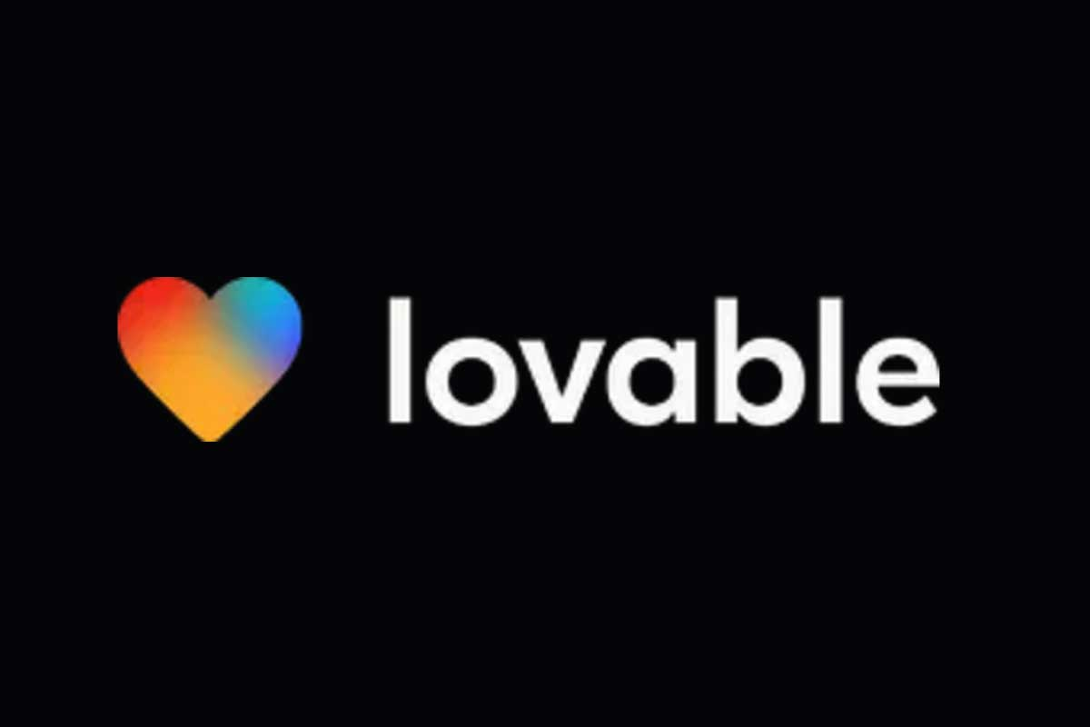

Theme 4: AI-Assisted App Development
“Create me a multiplayer online TicTacToe game”
Notes:
The original GitHub Copilot completes code in your editor
You have to accept small bits
You have to move your cursor around
You still have to type quite a lot
Copilot has to infer what you are trying to do
Can we switch POV to whole task, whole change, whole repository
While keeping the key learning of Copilot: repeated AI-user alignment

Slide 24
Theme 4: AI-Assisted App Development
Narrows the scope to app development
Usually narrows to particular design theme and backend services
The user can run app and validate directly
Sometimes little need to look at the code at all (vibe coding)
Huge caveats
App coding is replaced by app description
This is a small but important slice of the software industry
Good UX design is subjective, impossible to describe with words
Beware security disasters!

Slide 25
Continuous AI

Slide 26
Theme 5: Continuous AI
Continuous Integration
Continuous Deployment
Continuous AI
https://githubnext.com/projects/continuous-ai/
Notes:
The original GitHub Copilot completes code in your editor
You have to accept small bits
You have to move your cursor around
You still have to type quite a lot
Copilot has to infer what you are trying to do
Can we switch POV to whole task, whole change, whole repository
While keeping the key learning of Copilot: repeated AI-user alignment

Slide 27
Inner Loop, Outer Loop
Continuous AI is any automated use of AI to facilitate software engineering, on any platform, anywhere
https://githubnext.com/projects/continuous-ai/
Notes:
They are automatable: They can be performed by AI with a high degree of reliability and accuracy.
They are repetitive: They involve ongoing tasks that benefit from automation, such as updating documentation or managing issues.
They are collaborative: They enhance team workflows and improve the overall software development process.
They are integrated: They can be seamlessly integrated into existing workflows and platforms, such as GitHub.
They are auditable: They can be monitored and controlled by teams and organizations, ensuring transparency, accountability and utility.
They can be organization-specific: There are many different ways to implement these tasks, depending on the specific needs of the team or organization.
They are event-triggered: They can be triggered by events in the software development process, such as code changes, issue creation, or pull requests, and care must be taken to balance rate of triggering with other goals.

Slide 28
Continuous AI
implemented by
Agentic Workflows

Slide 29
Example - Weekly Researcher
---
on:
schedule:
- cron: "0 9 * * 1" # Every week, 9AM UTC, Monday
workflow_dispatch:
safe-outputs:
create-issue:
tools: web-search: ---
# Agentic Weekly Researcher (Ruby)
Do a deep research investigation in ${{ github.repository }} repository, and the related industry in general.
- Read selections of the latest code, issues and PRs for this repo.
- Read latest trends and news from the software industry news source on the Web.
Create a new GitHub issue containing a markdown report with interesting news about the area related to this software project, related products and competitive analysis, related research papers, new ideas, market opportunities, business analysis, enjoyable anecdotes.
> NOTE: Include a link like this at the end of the report:
```
> AI-generated content by ${{ github.workflow }}, may contain mistakes.
```
Triggers
Safe output specs
NL programming = deliberate ambiguity = genuinely useful ambiguity
Tools
Actions-familiar
Assumes GitHub
Self-reporting

Slide 30
Example - Issue Triage
---
on:
issues:
types: [opened, reopened]
safe-outputs:
add-comment:
---
# Agentic Issue Triage
Your task is to analyze issue #${{ github.event.issue.number }} and perform some initial triage tasks related to that issue.
Analyze the issue content. Write notes, ideas, nudges, resource links, debugging strategies and/or reproduction steps for the team to consider relevant to the issue. Select appropriate labels already used in the repository and apply them to the issue.
Finalize an output report with your analysis and add it as an issue comment to the issue.
> NOTE: Include a link like this at the end of your issue comment:
```markdown
> AI-generated content by ${{ github.workflow }}, may contain mistakes.
```

Slide 31
Agentic Workflows - Getting Started
Samples
gh extension install github/gh-aw gh aw add githubnext/agentics/daily-test-improver <secret+commit+push> gh aw run daily-test-improver --repeat 30

Slide 32
Agentic Workflows - Safety, Safety, Safety
Execution is VM-sandboxed (GitHub Actions VMs)
Overall permissions are minimized
Agentic steps run essentially read-only
All outputs are “in the intended channel” (“safe outputs”)
blast radius greatly reduced
checked by AI for safety
human oversight guaranteed
Outgoing network is firewalled and controlled

Slide 33
Continuous AI
implemented by
Agentic Workflows
enables
Agent Zoo

Slide 34
Continuous AI
implemented by
Agentic Workflows
enables
Continuous Engineering

Slide 35

Theme 5: The Repository as an Automated Software Factory
Continuous Integration
Continuous Deployment
Continuous AI
CI/CD is a form of automated factory
Automation happens proactively
Notes:
The original GitHub Copilot completes code in your editor
You have to accept small bits
You have to move your cursor around
You still have to type quite a lot
Copilot has to infer what you are trying to do
Can we switch POV to whole task, whole change, whole repository
While keeping the key learning of Copilot: repeated AI-user alignment

Slide 36
Example: Proactive fault investigation
Fault investigation happens proactively
AI agent gathers all information about fault, analyses, recommends
💣
Notes:
The original GitHub Copilot completes code in your editor
You have to accept small bits
You have to move your cursor around
You still have to type quite a lot
Copilot has to infer what you are trying to do
Can we switch POV to whole task, whole change, whole repository
While keeping the key learning of Copilot: repeated AI-user alignment

Slide 37
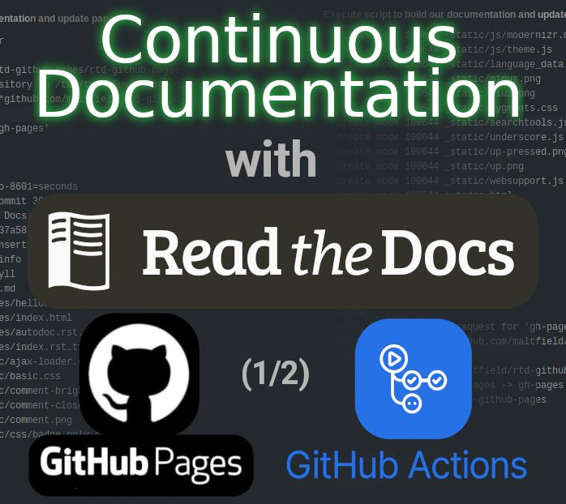
Example: Continuous Documentation
Automatically write and maintain software documentation
Automatically write and maintain specifications
Notes:
The original GitHub Copilot completes code in your editor
You have to accept small bits
You have to move your cursor around
You still have to type quite a lot
Copilot has to infer what you are trying to do
Can we switch POV to whole task, whole change, whole repository
While keeping the key learning of Copilot: repeated AI-user alignment

Slide 38
Continuous Perf Engineering: Linear, not Swarms
Swarms are cooperating, concurrent agents with different roles
They create many conflicts, duplication, overlap and need careful coordination and planning
Linear phasing is often more productive
Research → Plan → Prepare → Dev/Measure → Reproduce → Dev/Measure → Reproduce → Dev/Measure → Reproduce → Plan → Prepare → ….

Slide 39
Theme 6: New Futures, New Work
The Future is Work that wasn’t being done before
Automobile
Led to travel that wasn’t being done before
Factory
Led to millions of products that weren’t being produced before
Medicine
Led to many diseases that weren’t being treated before
More overall work, not less
New work, not less work
Notes:
The original GitHub Copilot completes code in your editor
You have to accept small bits
You have to move your cursor around
You still have to type quite a lot
Copilot has to infer what you are trying to do
Can we switch POV to whole task, whole change, whole repository
While keeping the key learning of Copilot: repeated AI-user alignment

Slide 40
Theme 6: New Futures, New Work
Software Performance Engineering was previously expensive, adhoc, ephemeral
→ AI-automated performance engineering now tractable
→ Needs human expertise and oversight
→ Good work that was too expensive to do
Formal Verification was previously very expensive, rare
→ AI-automated formal verification now looking tractable
→ 100x less expensive
→ Needs human expertise and oversight
Software Maintenance was previously very expensive, needed experts
→ AI-assisted software maintenance now tractable
→ 20x(?) less expensive
→ Needs human expertise and oversight
Notes:
The original GitHub Copilot completes code in your editor
You have to accept small bits
You have to move your cursor around
You still have to type quite a lot
Copilot has to infer what you are trying to do
Can we switch POV to whole task, whole change, whole repository
While keeping the key learning of Copilot: repeated AI-user alignment

Slide 41
Demo – Repo Assist

Slide 42
My Answers!
“What will coding with AI look like in the future?”
Pinpoint, task-oriented and automated tools will be everywhere
Depth knowledge, technical description, guidance, expertise, rapid exploration become key
Requirements, validation, design, maintainability, improvement, security will be partially automated

Slide 43
My Answers!
“Does AI mean that code will be obsolete soon?”
No! Code will largely remain the record of ground truth
But development without AI will not be productive
Depth knowledge will be critical
Coding, quality, delivery, release, project management, security, networking, + all computer science

Slide 44
My Answers!
“How should I use AI tools in software development?”
Learn how to be a great programmer without AI
Embrace AI-assisted pinpoint, task-oriented, productivity, automation tools
Learn how all these tools work

Slide 45
We live in the most incredible of times
Coding is already magical, AI coding gives you wild powers
These powers are simple to use but need expert-level guidance
AI is changing coding fast, and good developers embrace some of it
dsyme@github.com @dsyme.bsky.social
Notes:
AI developer tools are changing the way we write software.
GitHub Copilot was one of the first such tools. It launched as a technical preview (essentially a closed beta) in June 2021. Today it has 1.8M paying users, and 50% of those users’ code is written by Copilot. Other companies such as Google report similar proportions of AI-generated code for their comparable AI code completion tools.
This will only increase as the next generation of tools comes online. These are tools that approach the problem at a higher level – for example, completing an entire development task as opposed to completing a line of code or a function
Copilot Workspace, Devin, Cursor, et al.

Slide 46

GitHub Next
Investigating the future of software development
githubnext.com

Slide 47
General lessons

Slide 48
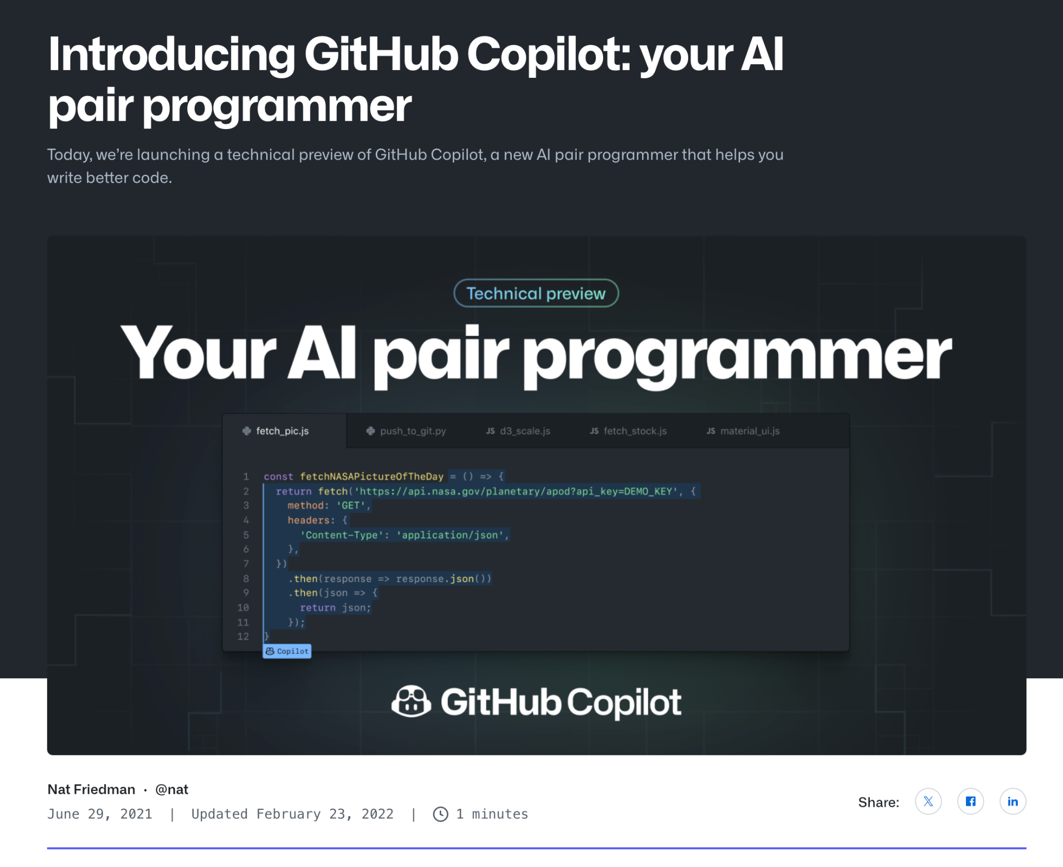
Lesson: A small team can build a big thing
Notes:
I wanted to share the example of original Copilot.
When original Copilot was introduced in June 2021, there were fewer than 10 people on the team. One of the great things about software is that a small team of great people can build something with huge impact. And this is what I meant by “asymmetric value” on the previous slide.

Slide 49
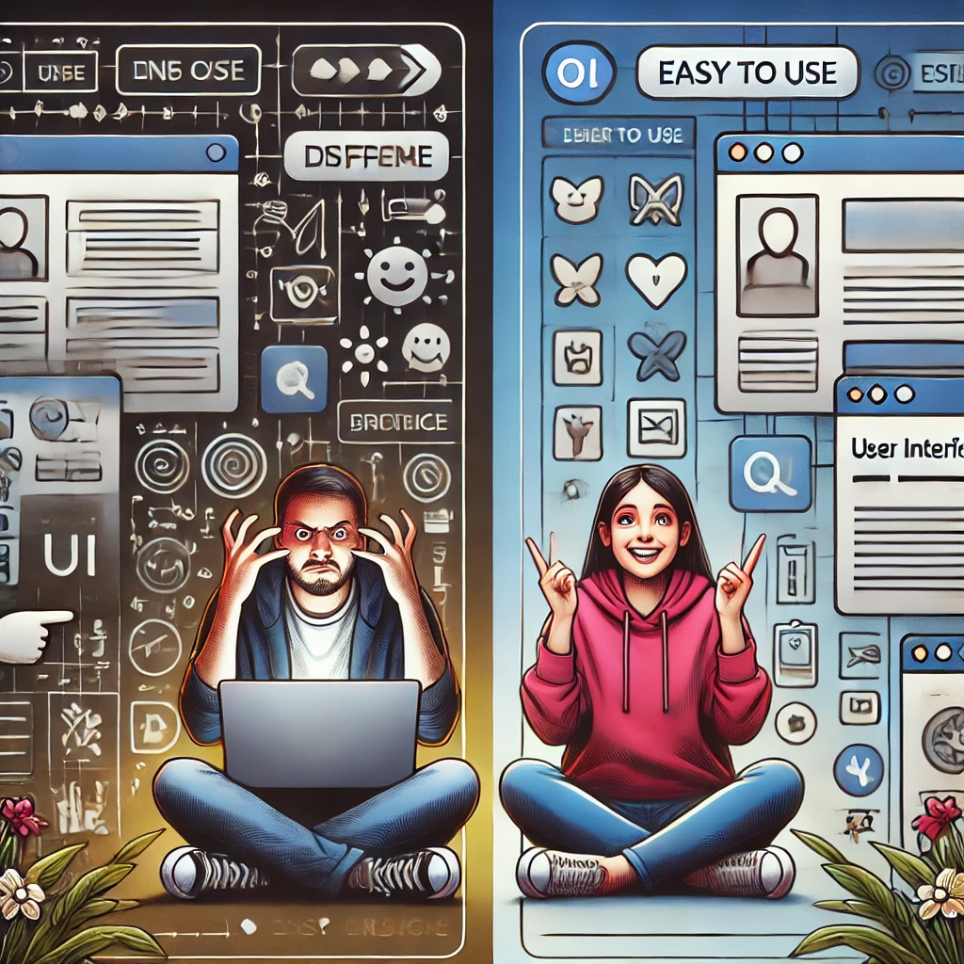
Lesson: UX is critical in AI developer tools
Notes:
In the PL and SWE communities, we have a long history of building really cool, innovative, useful tools that no one uses
Refactoring tools
Static analysis tools
Program verification or formal verification tools
Debugging tools
…. The list goes on and on
This is because we haven’t found the right UX to make these usable by real developers. And usually the people building the tools don’t have UX expertise to find the right UX.
Getting the UX right is the difference between success and failure

Slide 50
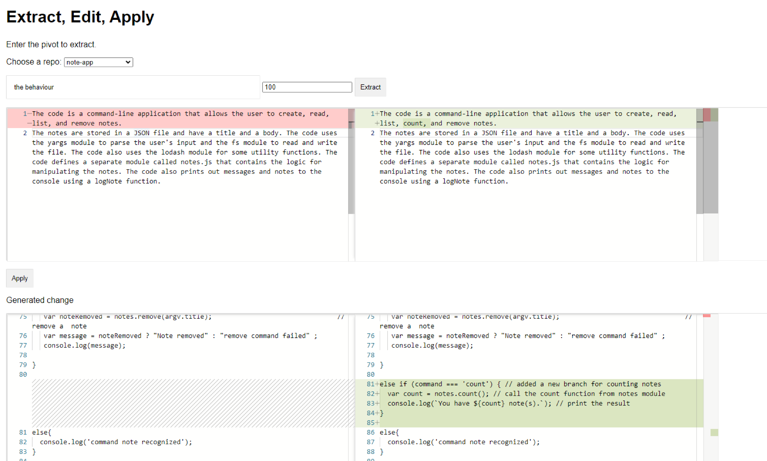
Copilot Workspace UI prototype
Notes:
Copilot Workspace aims to help a developer solve an entire development task, such as a feature request or bug report. It takes in a development task as input, finds the right places in a repo to address it, and then modifies the code.
This is what the first prototype of Copilot Workspace looked like. It was an experiment by one of our team members, Don Syme. He had been inspired by SpecLang, but where SpecLang wanted the NL to be the source of truth, Don wanted to explore keeping code as the source of truth, but enabling the user to modify it by editing a generated natural language specification.
He called it “Extract, Edit, Apply.” The user would first extract a specification of the code in a repo with respect to some topic (here it’s called the “pivot”), then edit that specification, then apply that edit to the code to update it in the way desired by the user.
Don is brilliant, but he’s not a front-end developer, and so you can see that this is rough, but it gets the idea across. And we’re kept the core flow of extracting a specification (and now a plan), and letting the user edit those and then apply or implement the changes in the code.

Slide 51
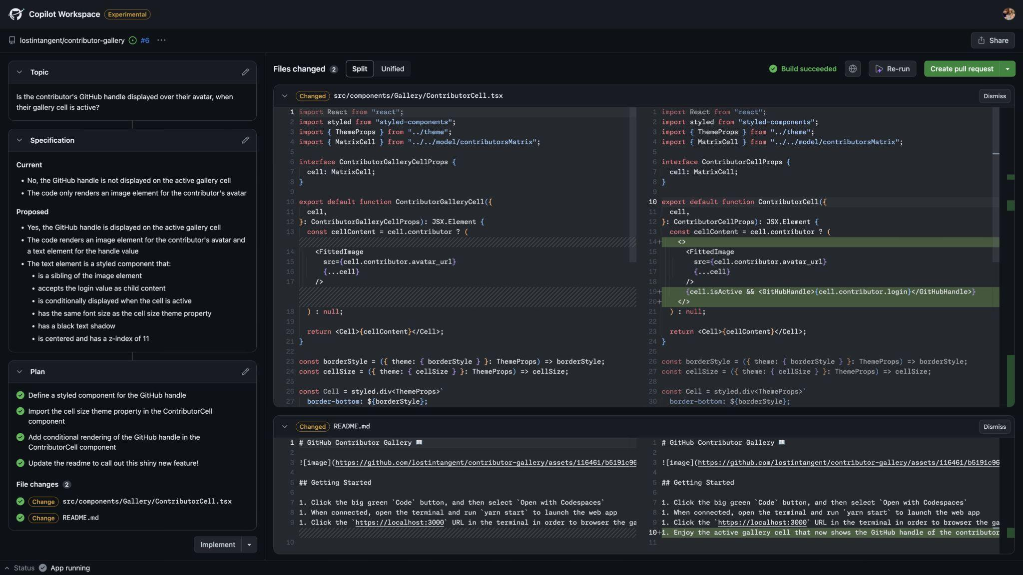
Copilot Workspace UI v1
Notes:
This is the first publicly shown version of CW. It was demoed at GitHub Universe in October 2023. At this point we had brought on our first front end developer, Cole Bemis, and he totally revamped CW, and it looked amazing. Cole previously worked on GitHub’s design system, Primer, and you can see his fingerprints on this – it’s now consistent with GitHub’s design language, and looks like a real product.

Slide 52
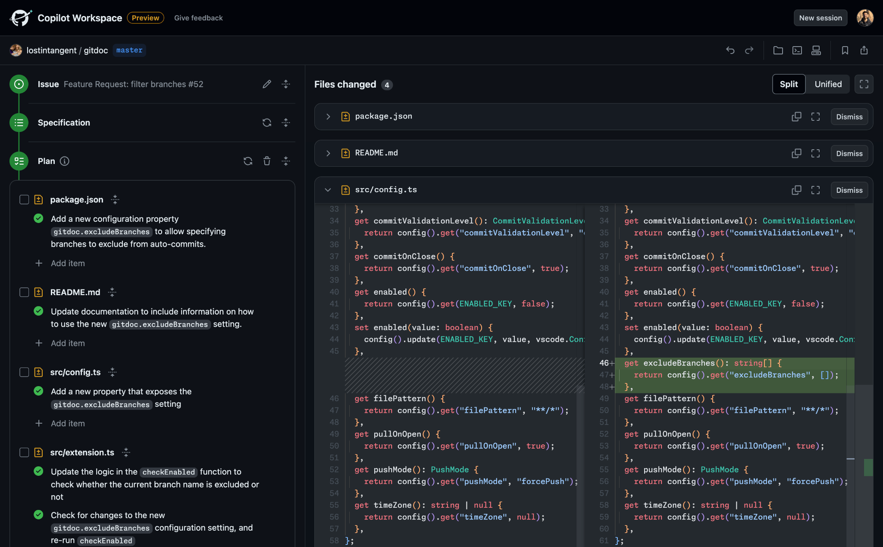
Copilot Workspace UI v2
Notes:
After Universe, we brought on a second frontend developer, Terkel Gjervik, and he revised the left hand side with a timeline view. This makes it clear how you are supposed to progress through the flow – start with the issue, proceed to spec, then generate a plan, then implement the code changes. This version has lasted the longest, from around March 2024 until very recently.

Slide 53
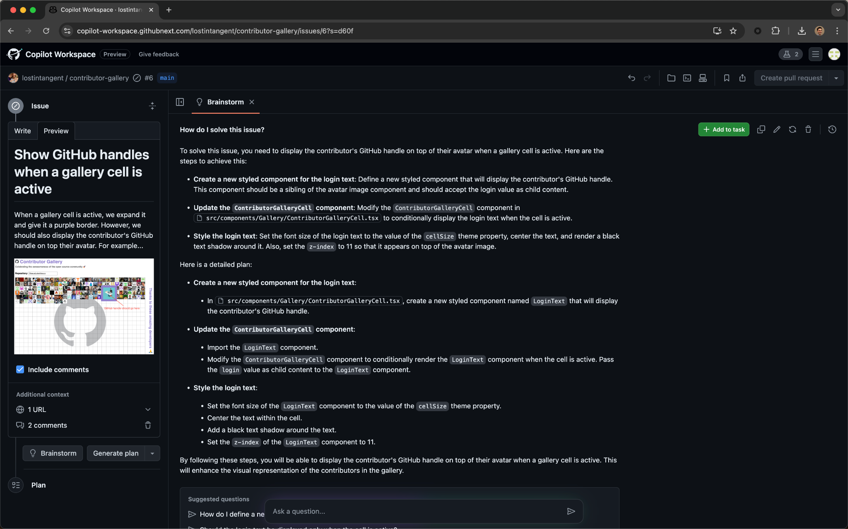
Copilot Workspace today
Notes:
This is the latest UI revamp, which is an “experiment” that our users can opt into. We heard feedback from our users they wanted help from Copilot Workspace before starting to implement. Often you might have an issue where you don’t actually know how to solve it, and users want to brainstorm possible approaches with the AI in the context of that issue and that repo. And so this version focuses on the brainstorming side of using CW.
You’ll note that it removes the spec and plan. This is a big change, and we want to see how users receive it before making it the default. But early feedback is very positive.
We’ve spent a lot of time and effort on the UX of Copilot Workspace, and we believe that having a well-designed and polished UX is critical to making it something our users love to use.

